Slide 1
BRAIN AGE ESTIMATION
By Kathakoli Sengupta

Slide 2
DATA PREPROCESSING
Input List Excel: /projectnb/bucbi/Kathakoli/Input List.xlsx
Input List:
Gulf_war_T1_T2: input_list_gwt1t2
GW_session2: input_List_GW2
GW_Alabama: : input_list_albama
GW_UCSF: input_list_ucsf
GW_Georgetown: input_list_g
ADNI1_CN: inputlistadni1
ADNI2_CN: inputlistadni2
NACC_T1: input_list_NACC
HCP_T1: input_list_HCP
UMass_T1: input_list_UMass
Scripts:
Skull Stripping: script.py
Linear Registration: flirt.py
Binary Mask: mask.py
Ravens Map: ravens.py

Slide 3
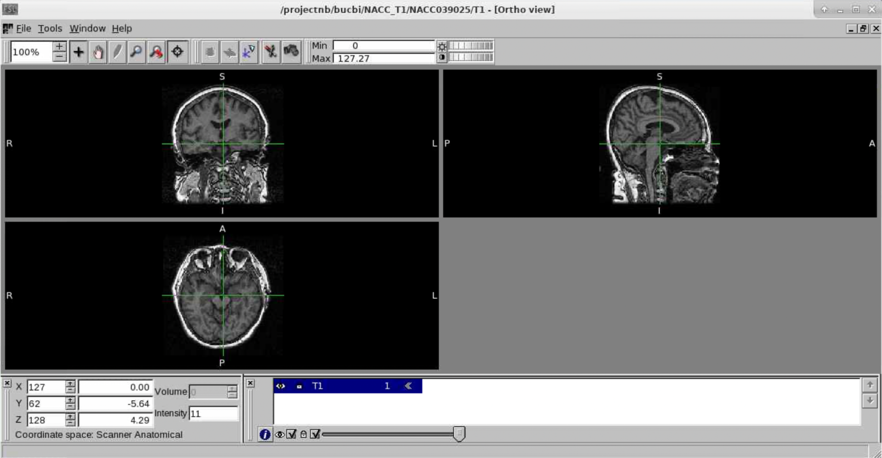
PREPROCESSING STEPS
BRAIN WITH SKULL

Slide 4
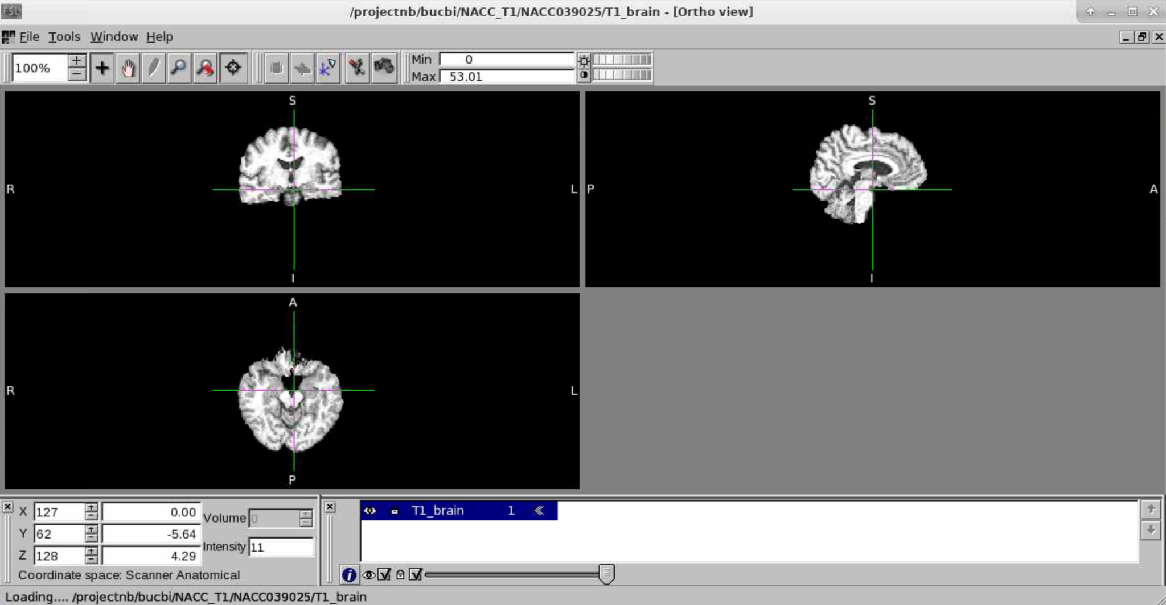
SKULL STRIPPED BRAIN

Slide 5
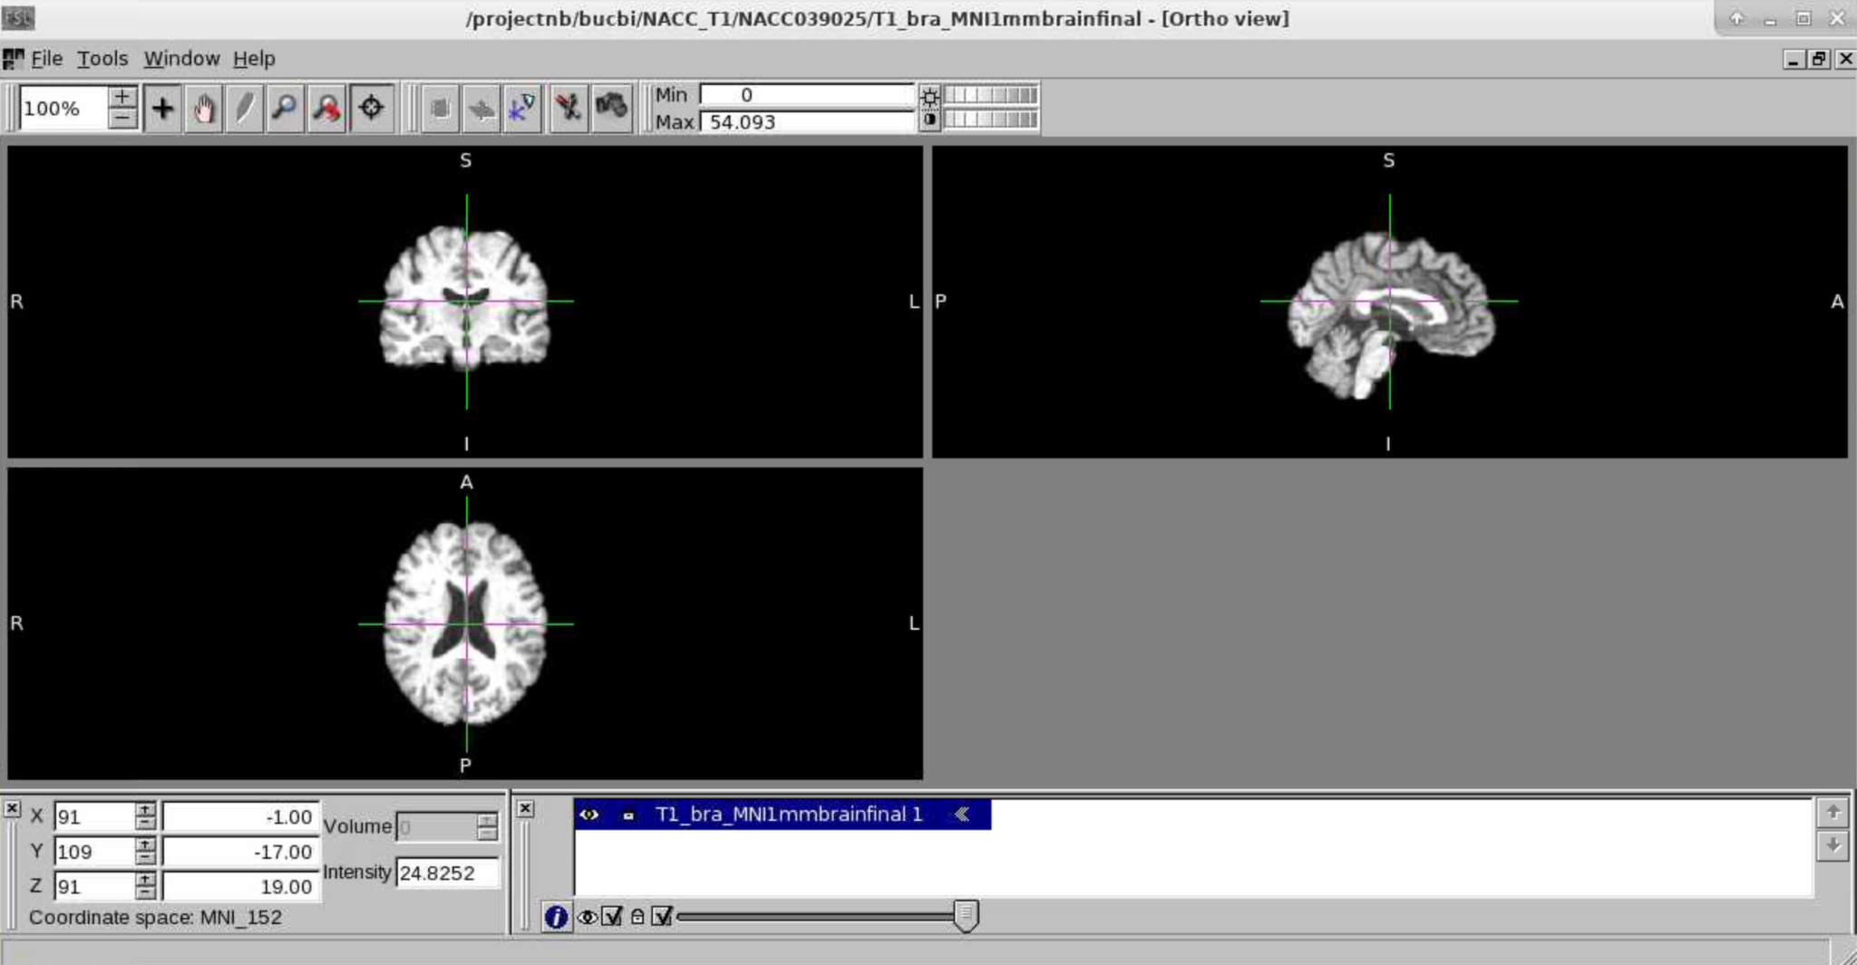
BRAIN WITH LINEAR REGISTRATION

Slide 6
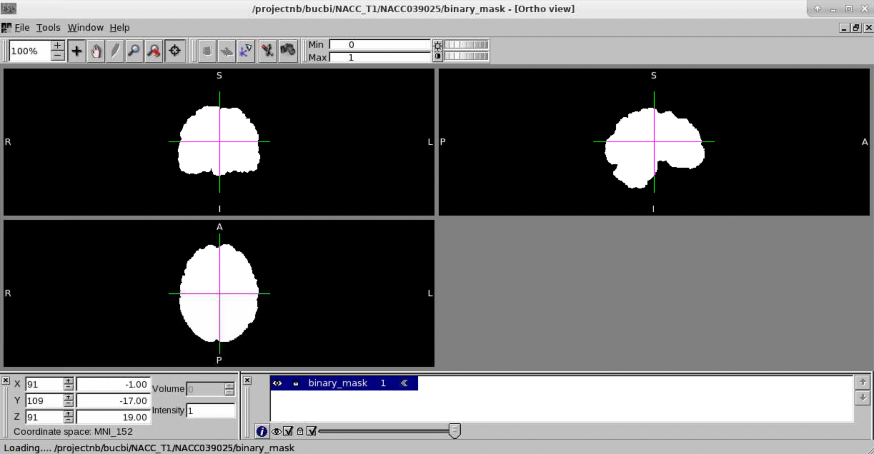
BINARY MASK

Slide 7
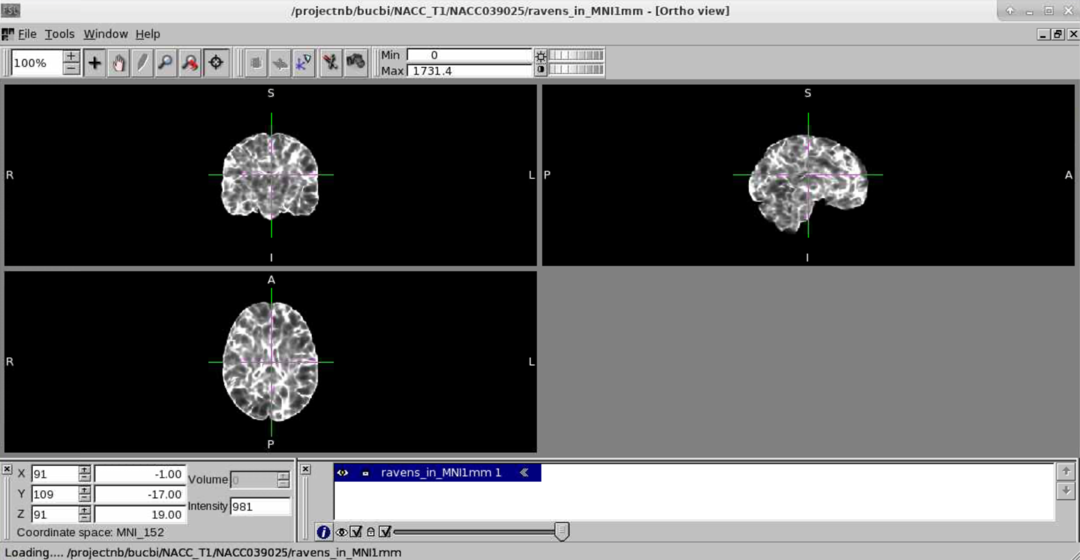
RAVENS MAP

Slide 8
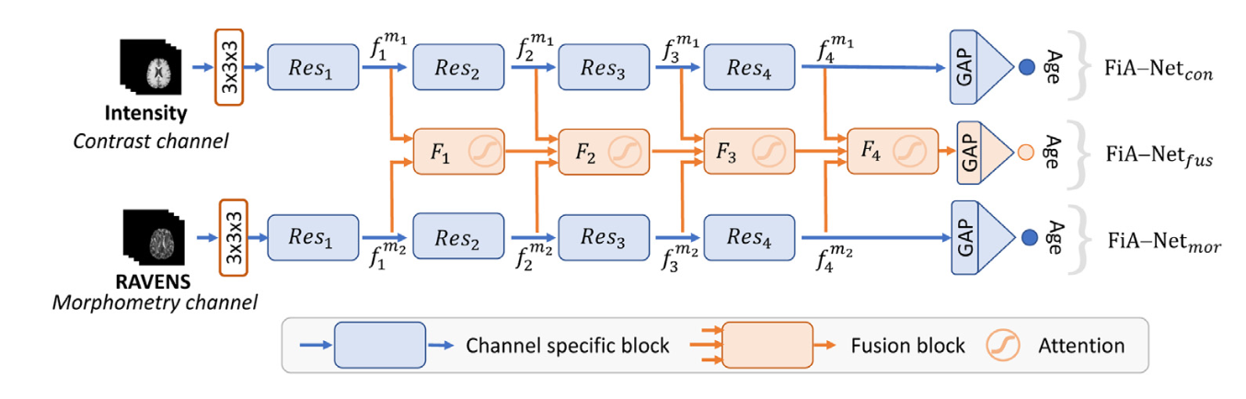
ARCHITECTURE-FIANET
Paper Link: https://www.sciencedirect.com/science/article/pii/S1361841521001377

Slide 9
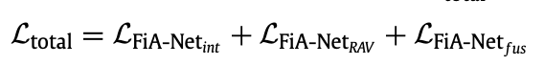
TRAINING SPECIFICATIONS
Learning Rate: 0.001
Optimizer: Adam
Epochs: 100
Batch Size: 1
Loss Function(MAE):
Scripts:
Dataloader: dataset.py(Attached)
Training: TrainingReg.py(Attached)

Slide 10
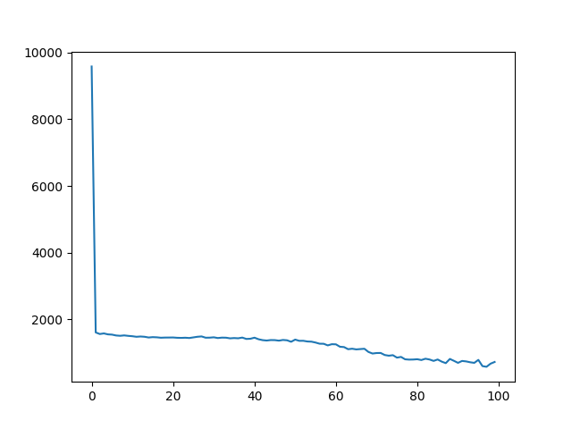
RESULTS
MODEL 1(NACC_T1)
Model: /projectnb/bucbi/Kathakoli/model1.pth
LOSS PLOT

Slide 11
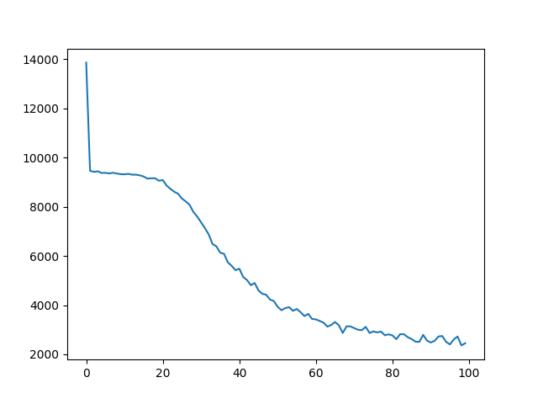
MODEL 2(Gulf war)
Model: /projectnb/bucbi/Kathakoli/model2.pth
LOSS PLOT

Slide 12
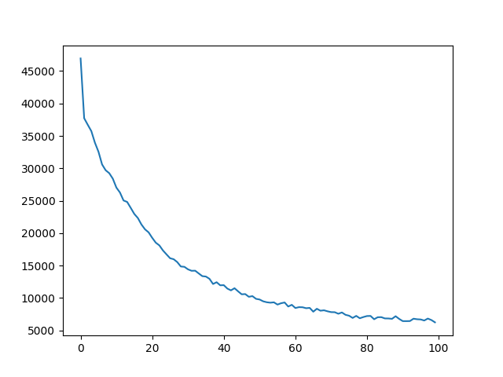
MODEL 3(NACC,HCP,UMASS,ADNI)
Model: /projectnb/bucbi/Kathakoli/model3.pth
LOSS PLOT

Slide 13
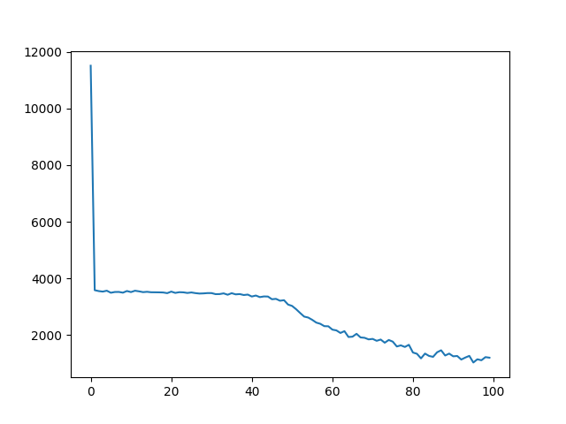
MODEL 4(UMass_T1)
Model: /projectnb/bucbi/Kathakoli/model4.pth
LOSS PLOT

Slide 14
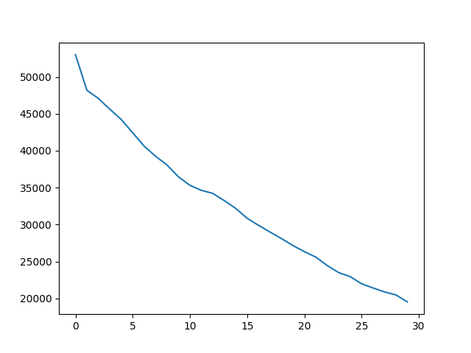
MODEL FINAL(GW, HCP,ADNI,NACC,UMass)
Model: /projectnb/bucbi/Kathakoli/modelfinal.pth
LOSS PLOT

Slide 15
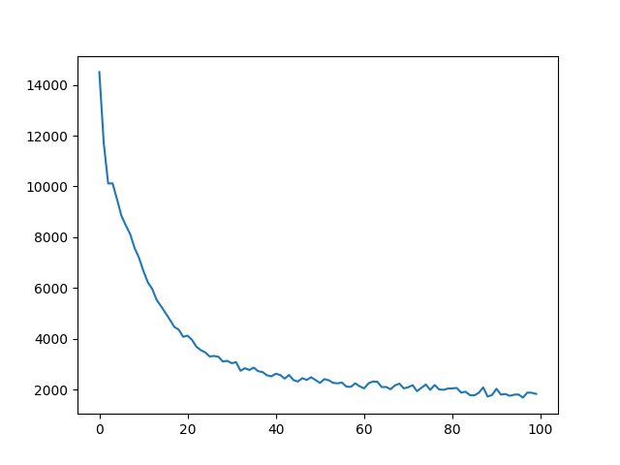
MODEL FUSION(GW, HCP,ADNI,NACC,UMass)
Model: /projectnb/bucbi/Kathakoli/modelfusonly.pth
LOSS PLOT

Slide 16
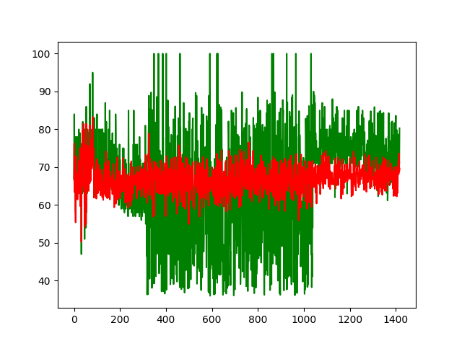
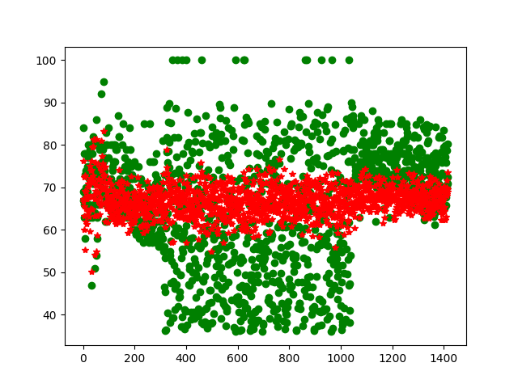
CORRELATION PLOTS
COGNITIVE NORMAL VS COGNITIVE NORMAL(NACC TRAINED MODEL)

Slide 17
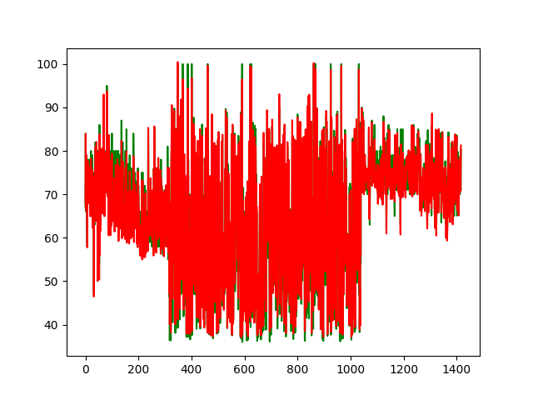
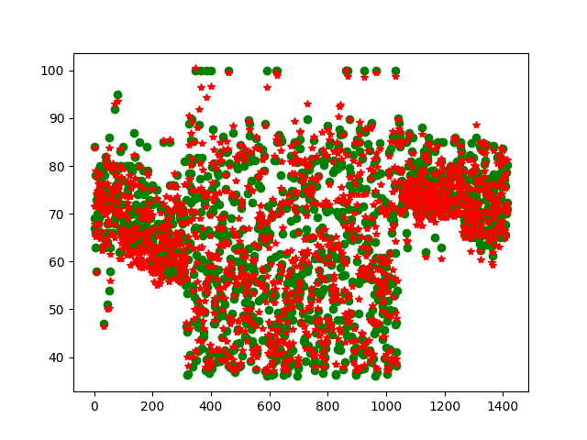
CORRELATION PLOTS
COGNITIVE NORMAL VS COGNITIVE NORMAL(ALL TRAINED MODEL)

Slide 18
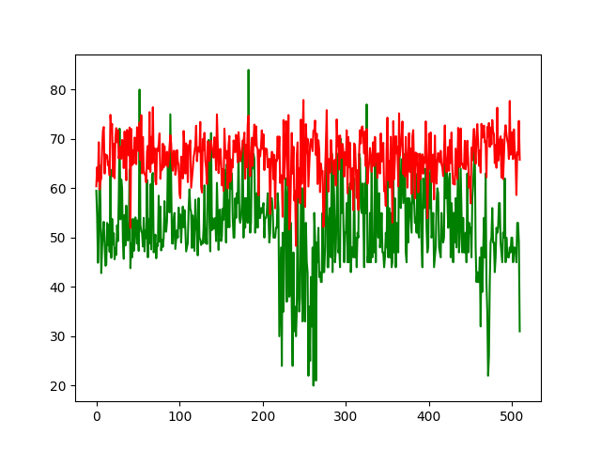
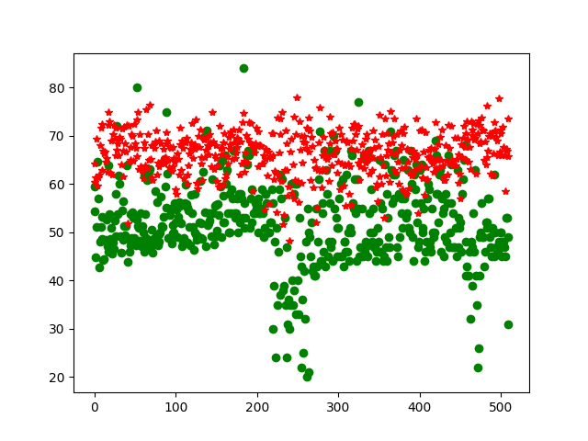
CORRELATION PLOTS
COGNITIVE NORMAL VS GULF WAR(ALL TRAINED MODEL)

Slide 19
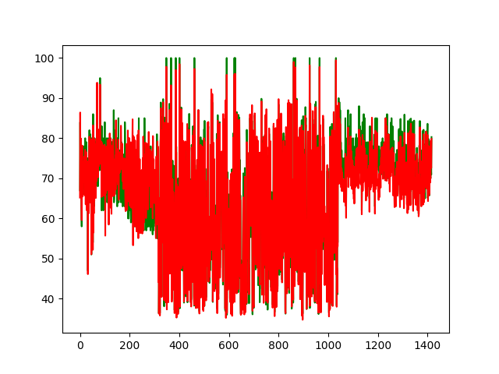
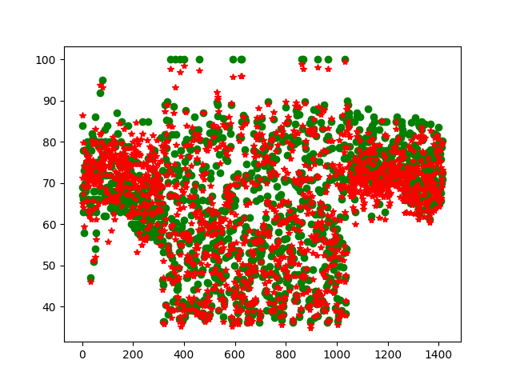
CORRELATION PLOTS
COGNITIVE NORMAL VS COGNITIVE NORMAL(FUS TRAINED MODEL)

Slide 20
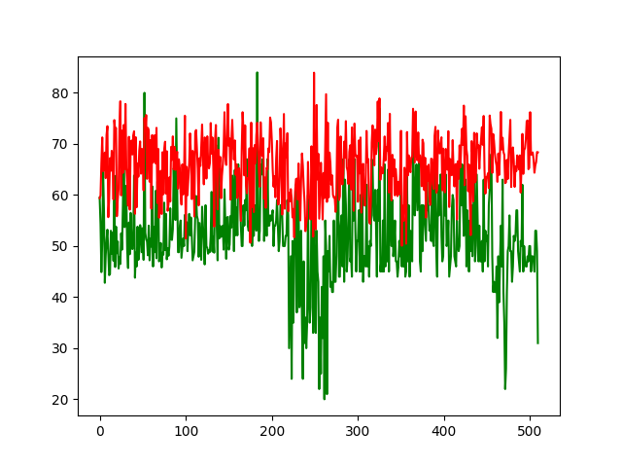
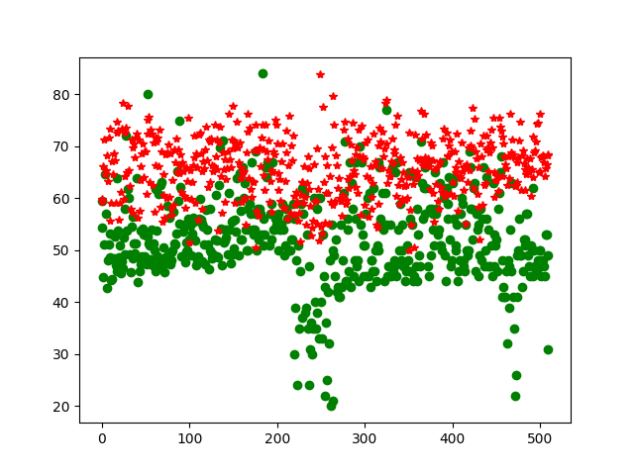
CORRELATION PLOTS
COGNITIVE NORMAL VS GULF WAR(FUS TRAINED MODEL)

Slide 21
CHALLENGES
The data we currently have is restricted age group data(20-100). The data they used had all possible patients ages from 0-97 years.
They have used N4 bias correction and FOV normalisation. Doing the same might improve our model performance.
FiANet uses 64,64,64 image so our image is resized to that. That might have resulted in some data loss. Cropping ROI might help in the process.
They had around 11000 training data and could perform good performance with 0.0001 LR and 25 epochs. Our data has only 4000 training points with GW patients. The learning rate was hence kept 0.001 ad the experiment was performed for more number of epochs.
The data is biased more to higher aged people including 100 years of age.
Our data is taken from different experiments, they had consistent data from the same setup.

Slide 22
WORK TO BE DONE
Train a final model with UMass, NACC, ADNI, HCP.(Monday)
Use a LR scheduler to choose the best LR throughout.
Use only fusion channel for the loss and not the summation of individual outputs and fusion output.
Once, the loss is significantly less while training , use cross-validation and CS for evaluation.
Segment the brain parts and train the same model for region wise analysis.
Correlation between each channel and the current age
Correlation changes with each model

Slide 23
SEGMENSEGMENTED BRAIN RESULT

Slide 24
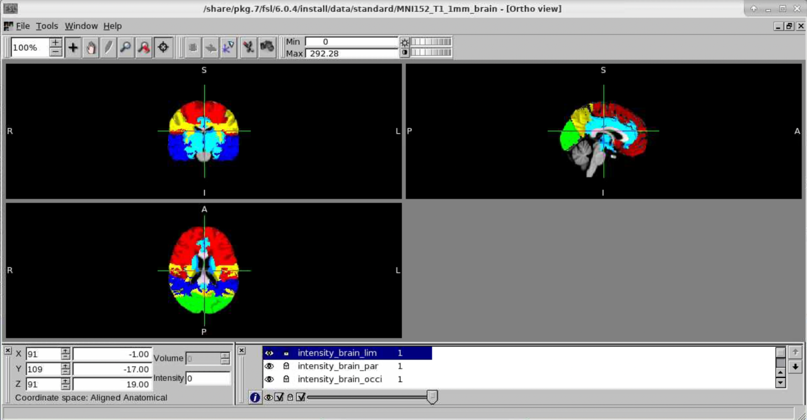
BRAIN SEGMENTATION(Intensity Maps)
Color Coding
Frontal: Red
Temporal: Blue
Occipital: Green
Parietal: Yellow
Limbic Sub-cortal: Light-blue

Slide 25

BRAIN SEGMENTATION(Ravens Maps)
Color Coding
Frontal: Red
Temporal: Blue
Occipital: Green
Parietal: Yellow
Limbic Sub-cortal: Light-blue

Slide 26
CORRELATION AND OBSERVATION PLOTS FOR UNFILTERED DATA

Slide 27
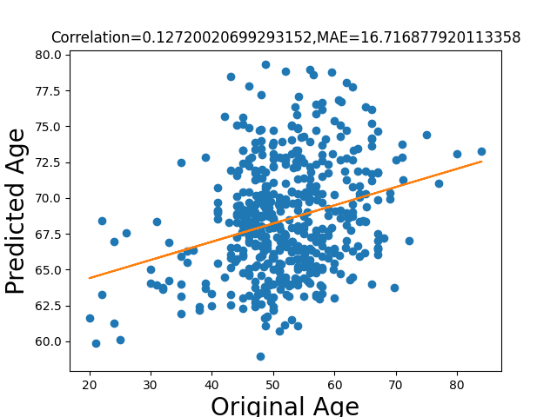
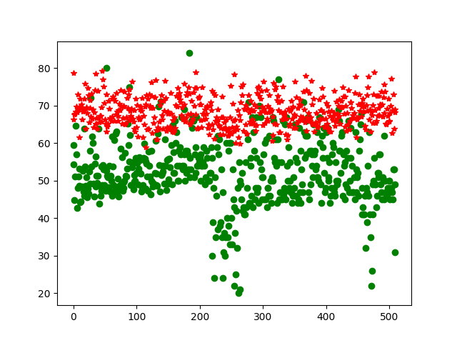
CORRELATION RESULTS
Frontal Lobe
Brain
Age
Green: Original Age
Red: Predicted Age
Number of observations

Slide 28
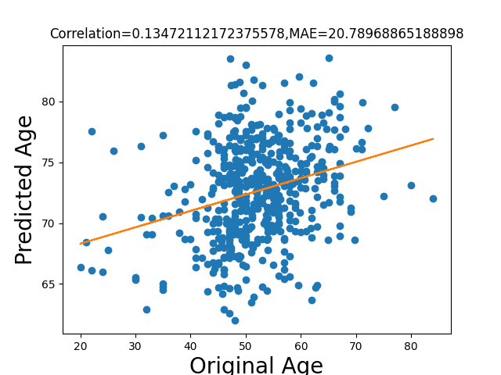
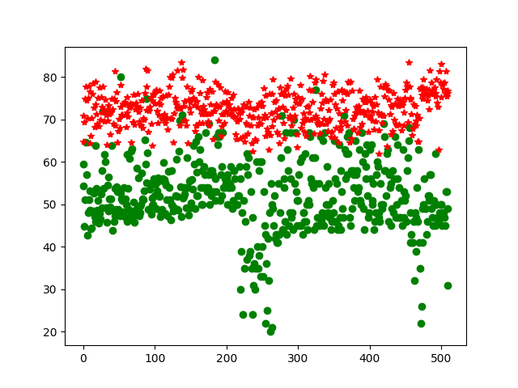
CORRELATION RESULTS
Temporal Lobe
Brain
Age
Green: Original Age
Red: Predicted Age
Number of observations

Slide 29
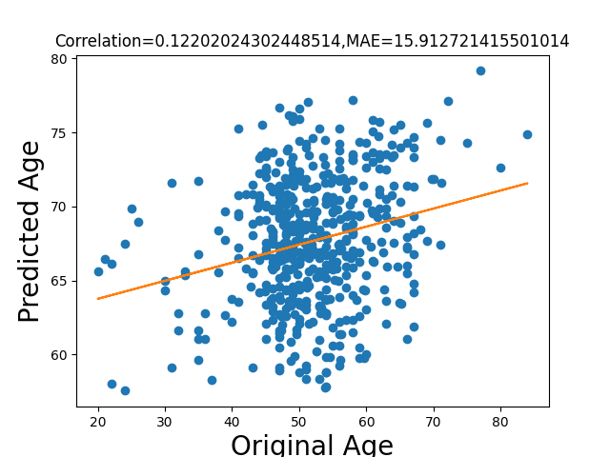
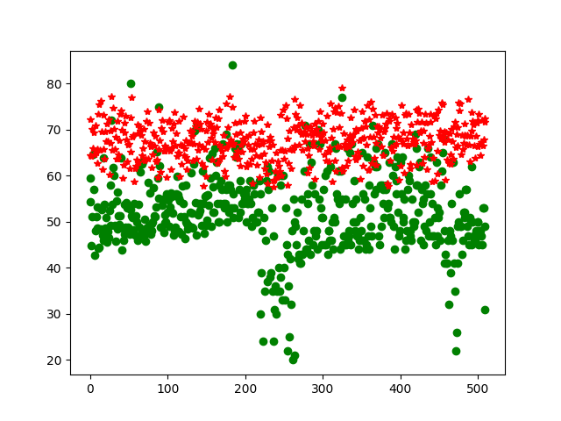
CORRELATION RESULTS
Parietal Lobe
Brain
Age
Green: Original Age
Red: Predicted Age
Number of observations

Slide 30
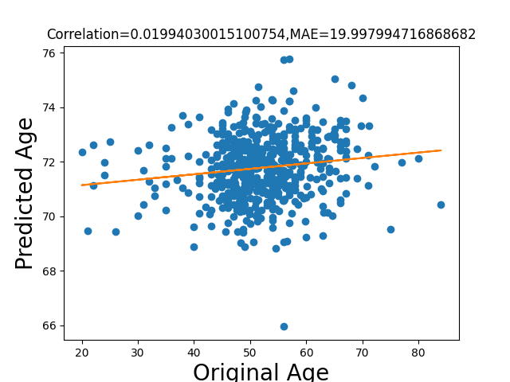
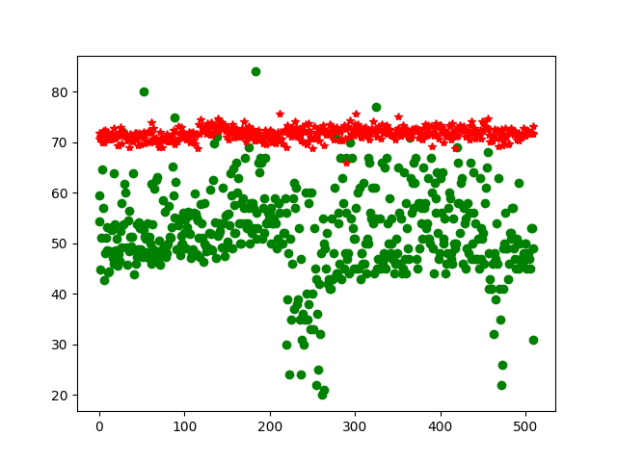
CORRELATION RESULTS
Occipital Lobe
Brain
Age
Green: Original Age
Red: Predicted Age
Number of observations

Slide 31
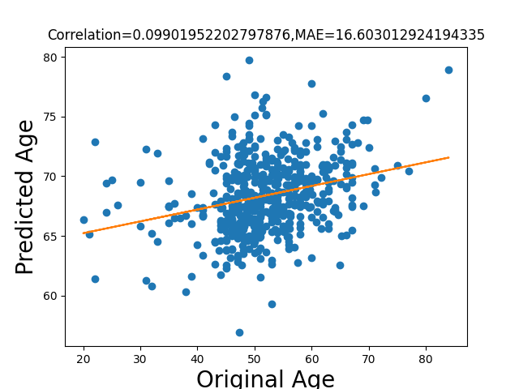
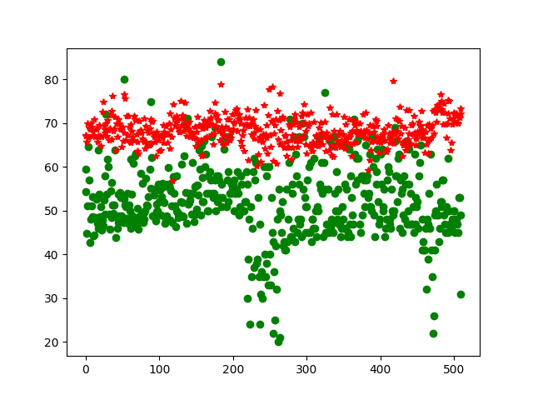
CORRELATION RESULTS
Limbic Subcortal Lobe
Brain
Age
Green: Original Age
Red: Predicted Age
Number of observations

Slide 32
CORRELATION AND OBSERVATION PLOTS FOR FILTERED DATA
( FUSION OUTPUT)

Slide 33
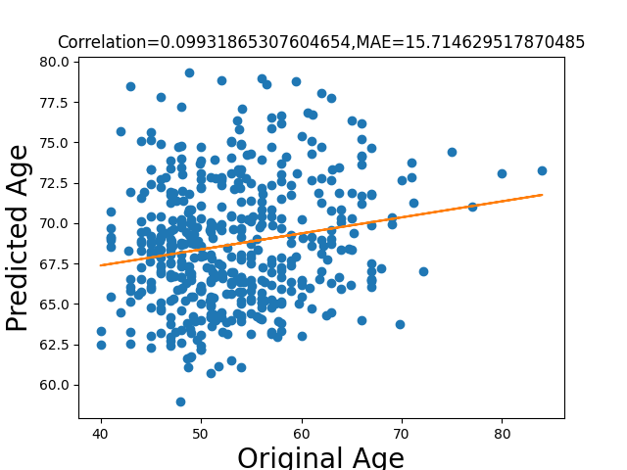
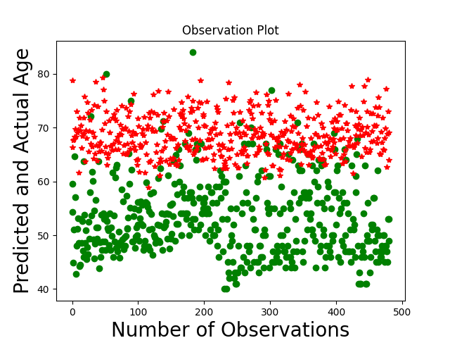
CORRELATION RESULTS
Frontal Lobe
Green: Original Age
Red: Predicted Age

Slide 34
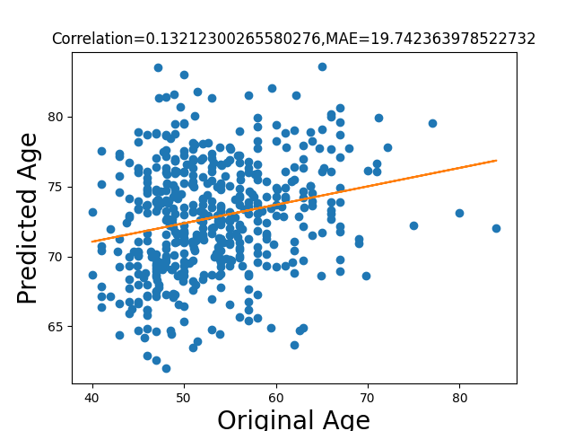
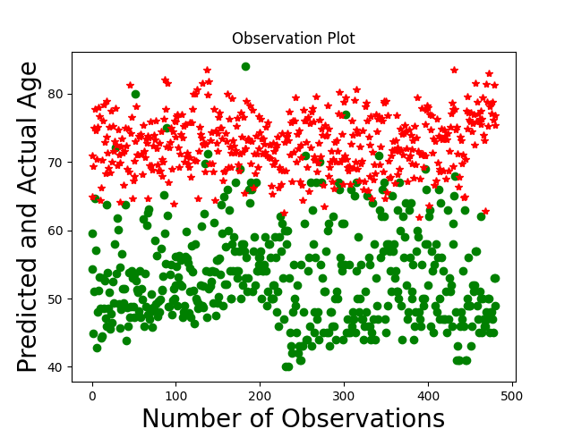
CORRELATION RESULTS
Temporal Lobe
Green: Original Age
Red: Predicted Age

Slide 35
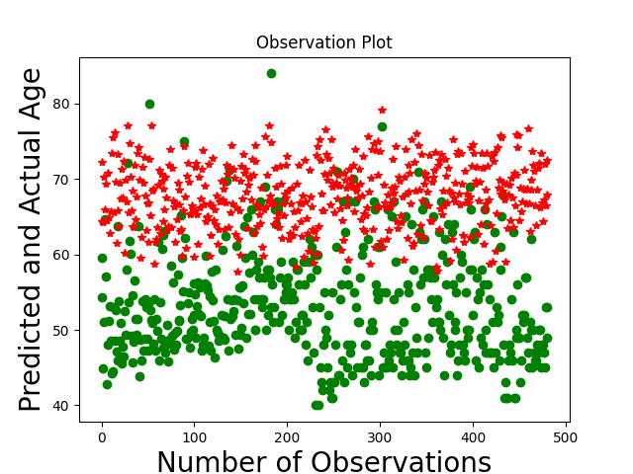
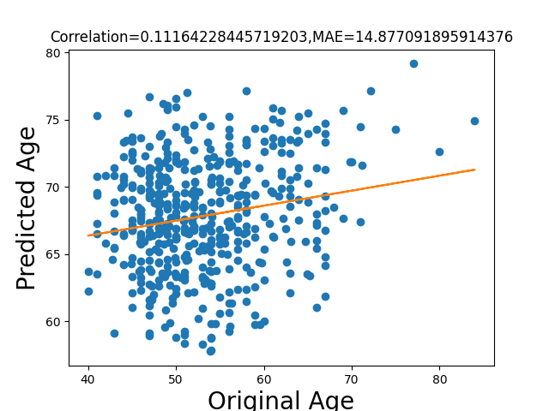
CORRELATION RESULTS
Parietal Lobe
Green: Original Age
Red: Predicted Age

Slide 36
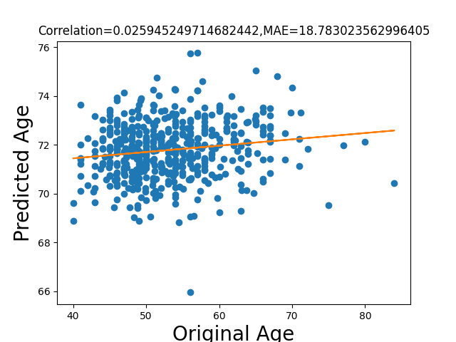
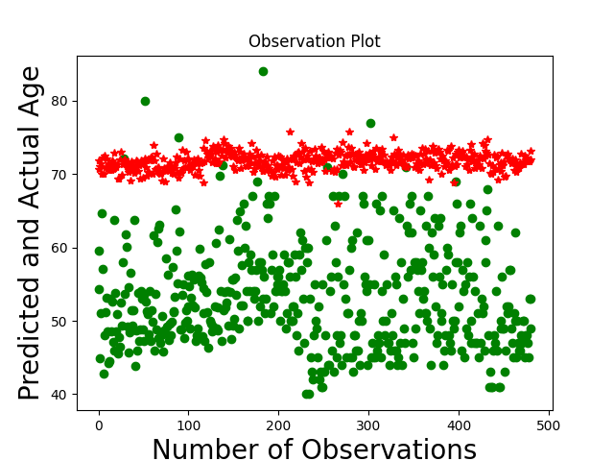
CORRELATION RESULTS
Occipital Lobe
Green: Original Age
Red: Predicted Age

Slide 37
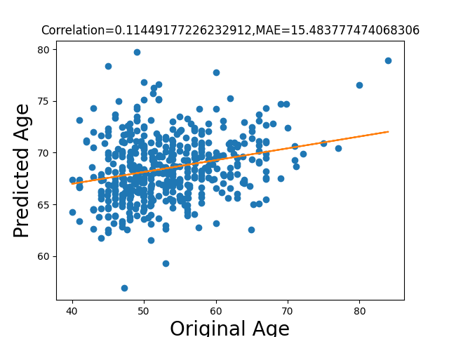
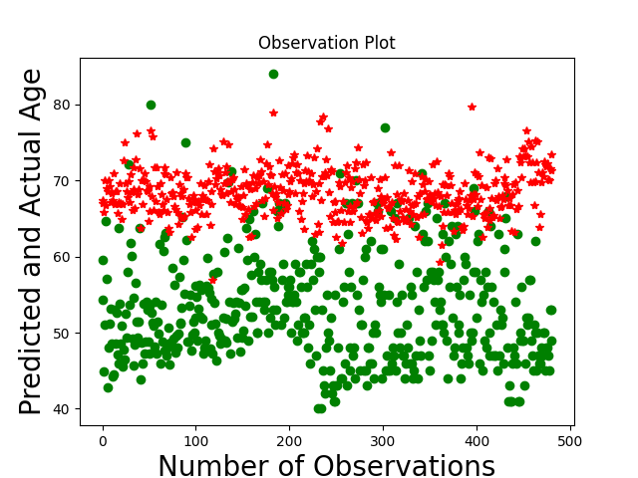
CORRELATION RESULTS
Limbic Subcortal Lobe
Green: Original Age
Red: Predicted Age

Slide 38
CORRELATION AND OBSERVATION PLOTS FOR FILTERED DATA
( 3 CHANNEL OUTPUT)

Slide 39
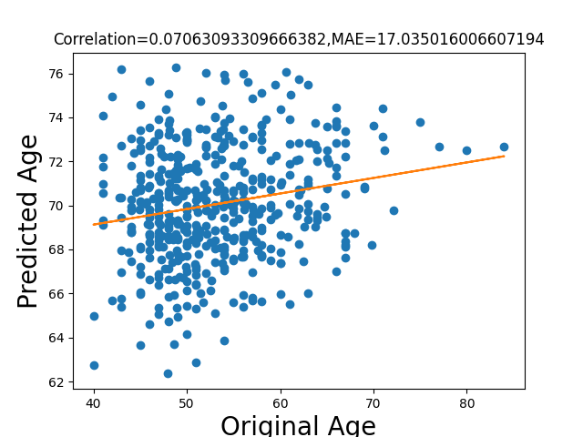
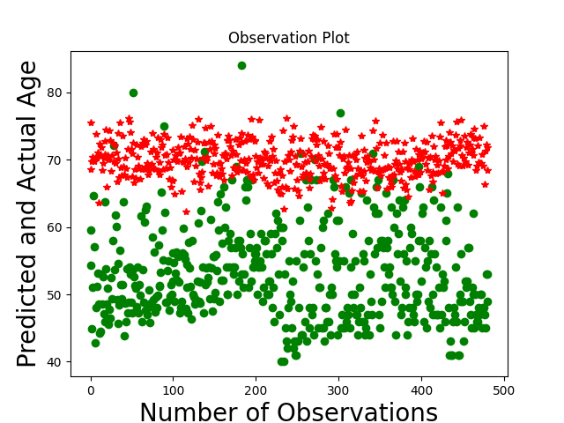
CORRELATION RESULTS
Frontal Lobe
Green: Original Age
Red: Predicted Age

Slide 40
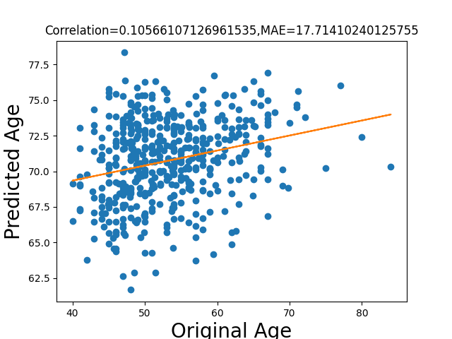
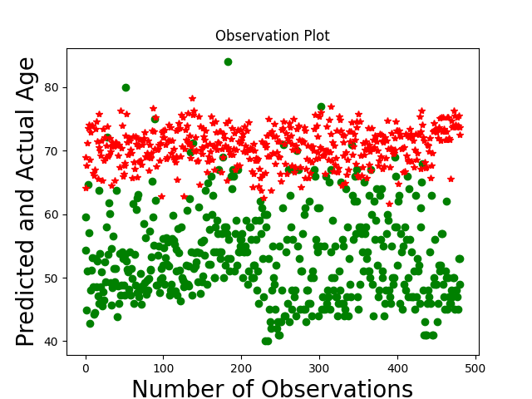
CORRELATION RESULTS
Temporal Lobe
Green: Original Age
Red: Predicted Age

Slide 41
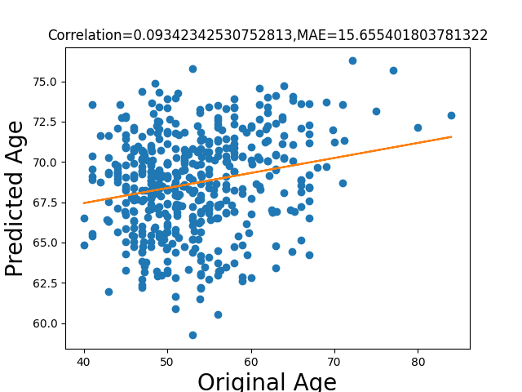
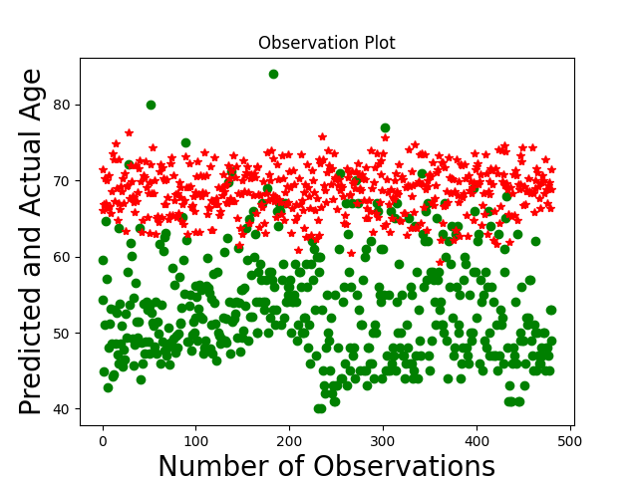
CORRELATION RESULTS
Parietal Lobe
Green: Original Age
Red: Predicted Age

Slide 42


CORRELATION RESULTS
Occipital Lobe
Green: Original Age
Red: Predicted Age

Slide 43


CORRELATION RESULTS
Limbic Subcortal Lobe
Green: Original Age
Red: Predicted Age

Slide 44
WITHOUT SEGMENTATION FUSION RESULT

Slide 45


CORRELATION RESULTS
Whole Brain Model
Green: Original Age
Red: Predicted Age
Why MAE so high? Is the model a poor one?
Answer: Premature Ageing
https://www.bu.edu/sph/news/articles/2019/gulf-war-veterans-aging-faster/
Recent research on Gulf War illness and other health problems in veterans of the 1991 Gulf War: Effects of toxicant exposures during deployment

Slide 46
DATA MANIPULATION

Slide 47

Data Manipulation Required
Research shows that models tend to overestimate brain age for participants younger than the mean, and underestimate it for participants older than the mean. (1,2).
Adolescence Data Required to be added:
HCP Development
ABCD
UKBiobank
Aycheh HM, Seong JK, Shin JH, Na DL, Kang B, Seo SW, et al. Biological brain age prediction using cortical thickness data: a large scale cohort study. Front Aging Neurosci. (2018) 10:252. doi: 10.3389/fnagi.2018. 00252
Liang H, Zhang F, Niu X. Investigating systematic bias in brain age estimation with application to post-traumatic stress disorders. Hum Brain Mapp. (2019) 40:3143–52. doi: 10.1002/hbm.24588
Ballester Pedro L., da Silva Laura Tomaz, Marcon Matheus, Esper Nathalia Bianchini, Frey Benicio N., Buchweitz Augusto, Meneguzzi Felipe,Predicting Brain Age at Slice Level: Convolutional Neural Networks and Consequences for Interpretability,Frontiers in Psychiatry

Slide 48

Data Manipulation Required
B. Cropping instead of Reshaping.
C. Two-tailed t-test to see Sex effects

Slide 49
Data Manipulation Required
D. ADASYN
Divide data into same width bins and perform adasyn.
E. Train-Test: 80-20 split Cognitive Normal Data
Haibo He, Yang Bai, E. A. Garcia and Shutao Li, "ADASYN: Adaptive synthetic sampling approach for imbalanced learning," 2008 IEEE International Joint Conference on Neural Networks (IEEE World Congress on Computational Intelligence), Hong Kong, 2008, pp. 1322-1328, doi: 10.1109/IJCNN.2008.4633969.

Slide 50
MODELS

Slide 51

Machine learning for brain age prediction: Introduction to methods and clinical applications

Slide 52

Deep Learning for Brain Age Estimation: A Systematic Review

Slide 53

Deep Learning for Brain Age Estimation: A Systematic Review

Slide 54
Modifications
Using Multi-modal Data
Choose correct feature space
Using significant slicing for the prediction

Slide 55

Multi-channel attention-fusion neural network for brain age estimation: Accuracy, generality, and interpretation with 16,705 healthy MRIs across lifespan(Github)

Slide 56

Multi-channel attention-fusion neural network for brain age estimation: Accuracy, generality, and interpretation with 16,705 healthy MRIs across lifespan

Slide 57

Multi-channel attention-fusion neural network for brain age estimation: Accuracy, generality, and interpretation with 16,705 healthy MRIs across lifespan

Slide 58

Multi-channel attention-fusion neural network for brain age estimation: Accuracy, generality, and interpretation with 16,705 healthy MRIs across lifespan

Slide 59

Patch-based Brain Age Estimation from MR Images

Slide 60


Patch-based Brain Age Estimation from MR Images
Bias Correction:

Slide 61

Patch-based Brain Age Estimation from MR Images

Slide 62

Accurate brain age prediction using recurrent slice-based networks

Slide 63

Accurate brain age prediction using recurrent slice-based networks

Slide 64

Predicting Brain Age at Slice Level: Convolutional Neural Networks and Consequences for Interpretability(Github)

Slide 65


Predicting Brain Age at Slice Level: Convolutional Neural Networks and Consequences for Interpretability

Slide 66

Meta-Transformer: A Unified Framework for Multimodal Learning

Slide 67
CONCLUSION

Slide 68
RESULT METRICS AND GRAPHS
Cross-validation Evaluation
Correlation Metrics:
Correlation(Slope)
MAE
R2
Plots
Saliency Maps(Especially for segmentation)

Slide 69
FUTURE WORK

Slide 70
Remove Data Bias
Implement Fianet with Meta Transformer
Evaluate model with metrics and saliency map(CN)
Calculate averaging weight for slice based model
Conclude Brain Age
Implement Patch-Based Model with Meta Transformer
Implement Slice-based model with Meta Transformer

